Slide 1
The party theme generator
Hifza Zaheer

Slide 2
The Product Brief
To create:
An application that generates “Objects” upon a set of predefined rules
A micro-service orientated architecture for the application
Utilization of Flask,Jinja2 for front-end website and integrated API's while Python and MySQL for back-end
Generating Random Objects
Utilizing Feature-Branch Model and creating an Ansible Playbook to install all dependencies via Playbook
Utilizing Jenkins, Ansible, Docker for CI/CD and Nginx for Load Balancing

Slide 3
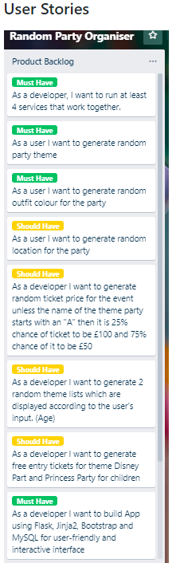
USER STORIES

Slide 4
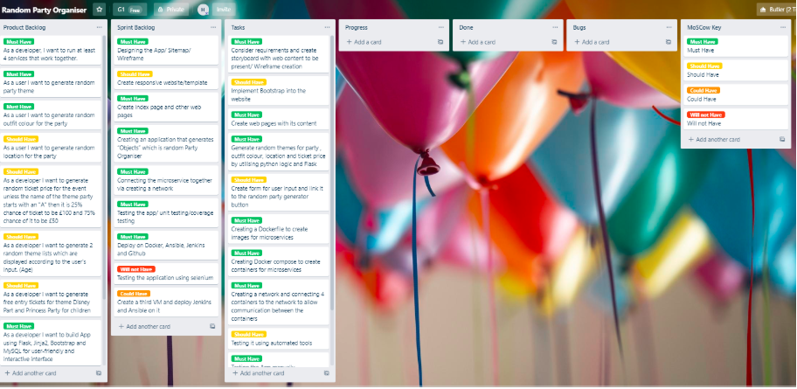
Initial Project planning/ trello

Slide 5
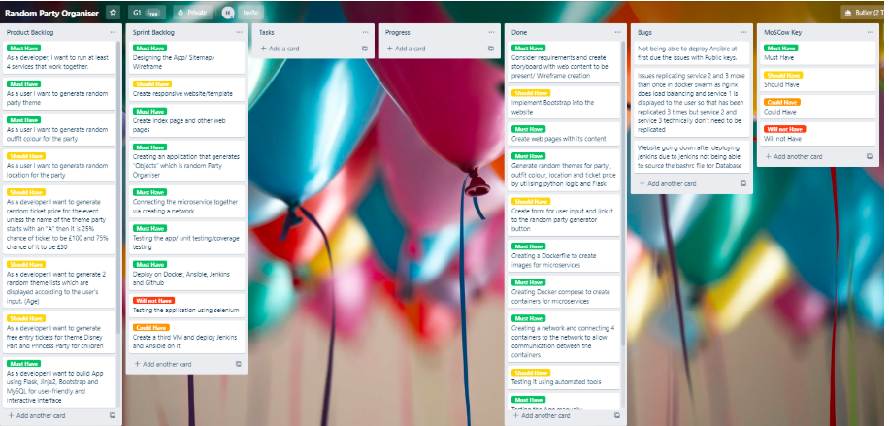
Final project planning/trello

Slide 6
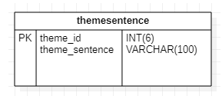
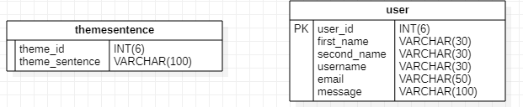
database design
Initial Design
Final Design

Slide 7
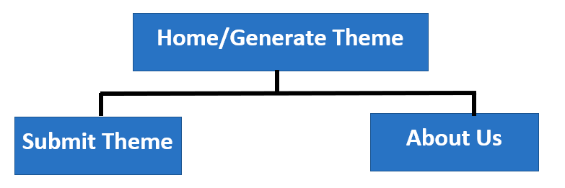
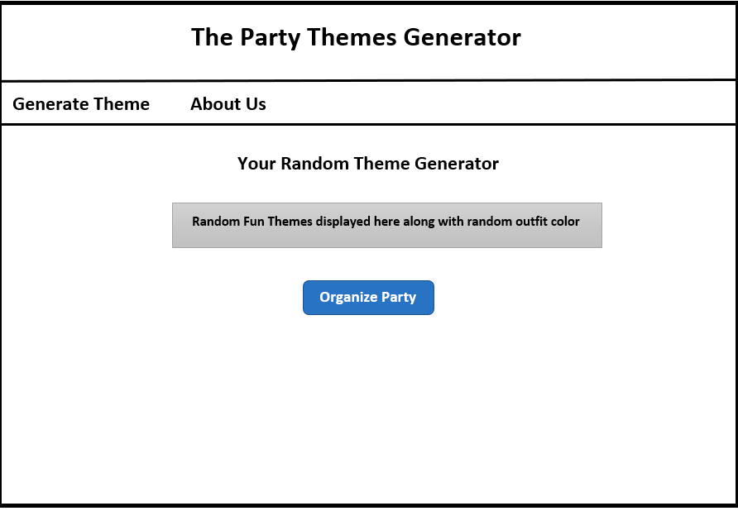
Initial Website design
Sitemap
Wireframe

Slide 8
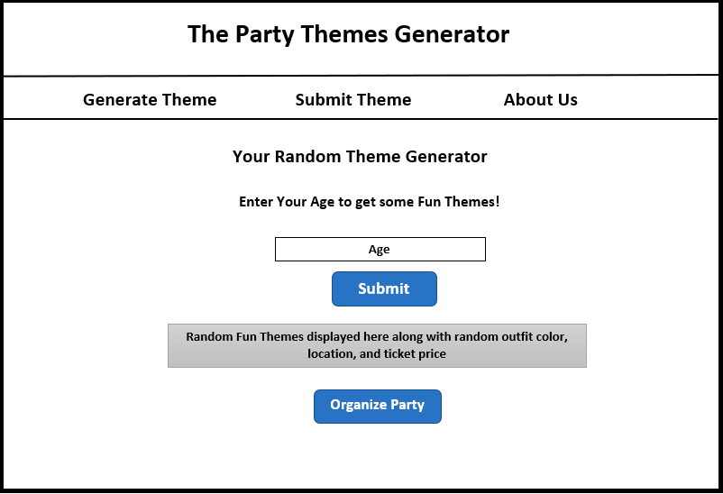
Final website design

Slide 9
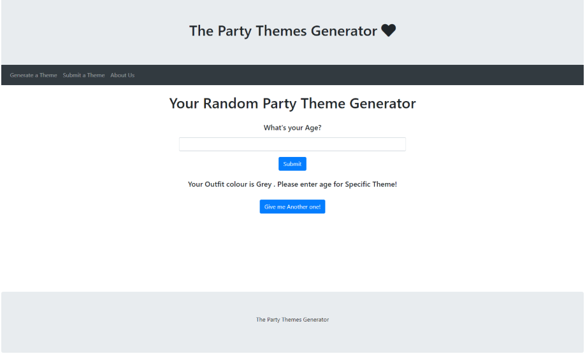
My solution

Slide 10
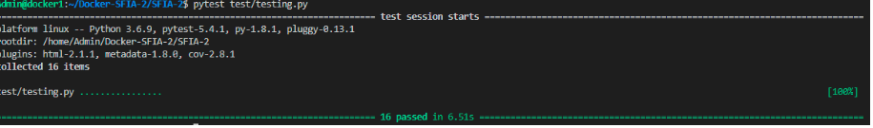
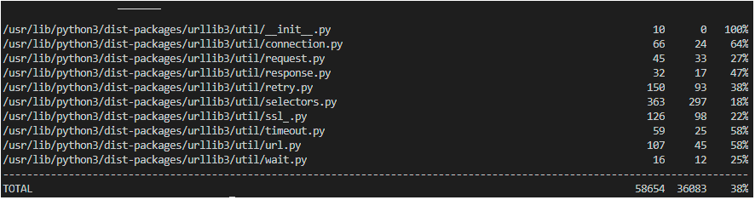
testing
Unit Testing
Coverage Testing

Slide 11
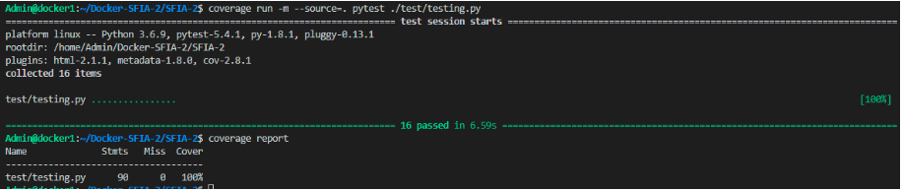
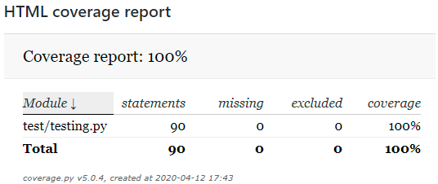
testing
Sourcing the test file gave 100% coverage report

Slide 12
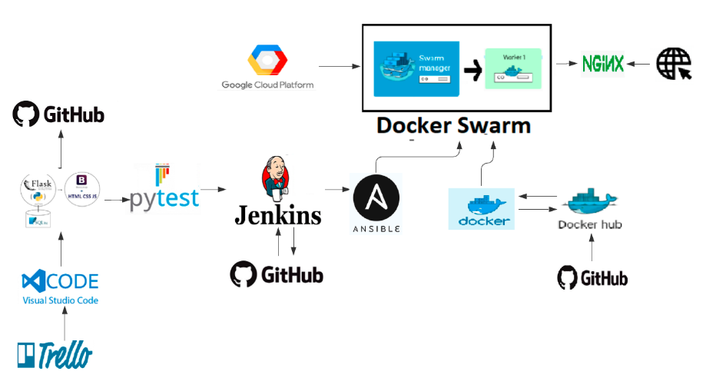
Technology overview

Slide 13
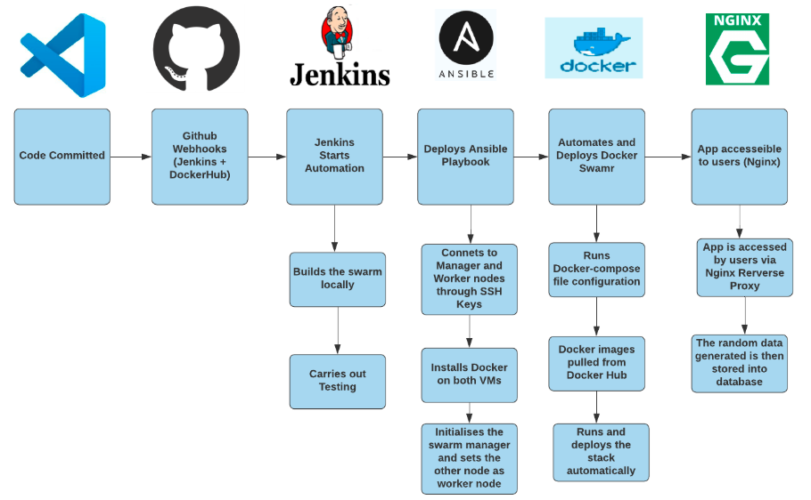
Deployment diagram

Slide 14
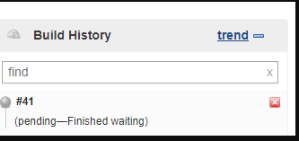
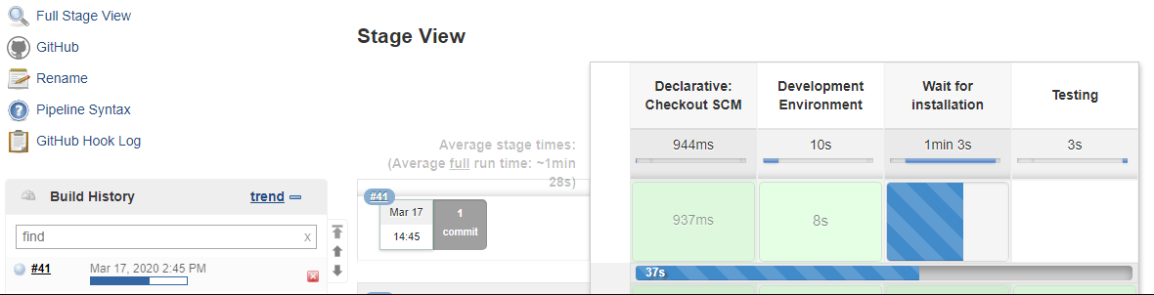
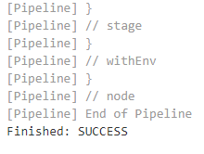
DEPLOYMENT/ JENKINS
Auto- Build using Webbooks
How the process looks:
Jenkins waiting to trigger the build once change was fully committed:
Jenkins Build triggered automatically once change was committed, deploying Ansible and Automating Docker Swarm in Development Environment and also does testing using Pytest:

Slide 15
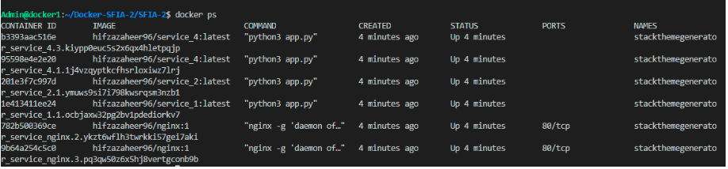
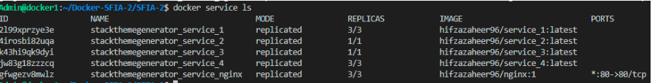
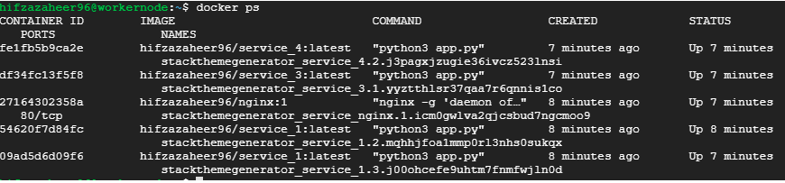
Successful deployment
Manager Node
Worker Node

Slide 16
Evaluation
What went well | Challenges | Future Improvements
Creating Dynamic App | Public Key issues when deploying Ansible | Adding CRUD functionality
Completing project on time | Replicated service 2 and service 3 more than once caused issues with the app functionality due to sessions | Selenium Testing
Testing the App | Website going down after deploying Jenkins as Jenkins could not source the bashrc file for Database | Third VM for Ansible and Jenkins
Linking GitHub to Jenkins via webhooks | Building and pushing the images to docker hub manually every time, after which GitHub was linked to Docker Hub for running this process efficiently. | Implement Volumes
Creating microservices | HTML POST METHOD | Carry out Stress testing

Slide 17

Any question?

